Slide 1
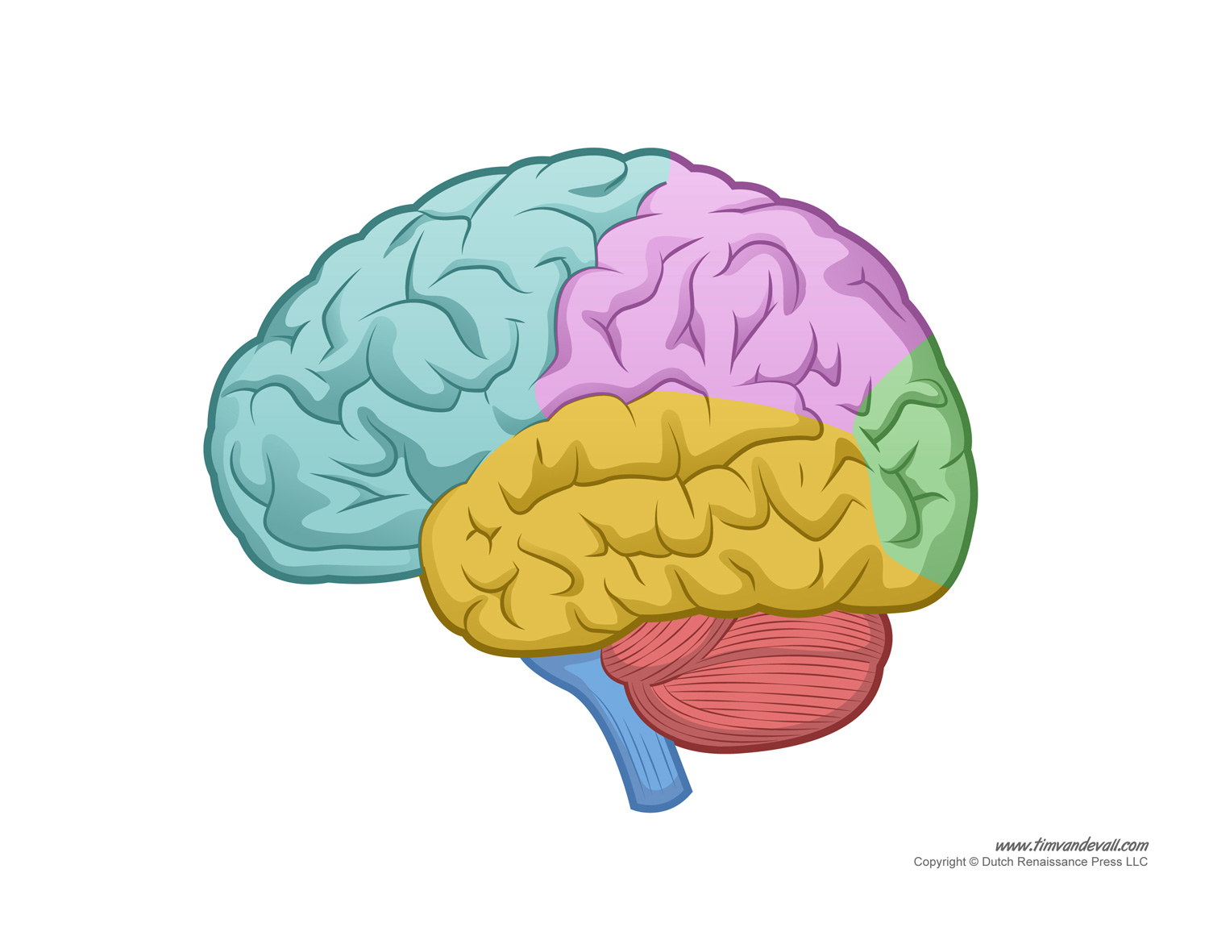
The Human Brain

Slide 2
Contents:
Introduction
Parts of The Human Brain
Functions of The Human Brain
Conclusion

Slide 3
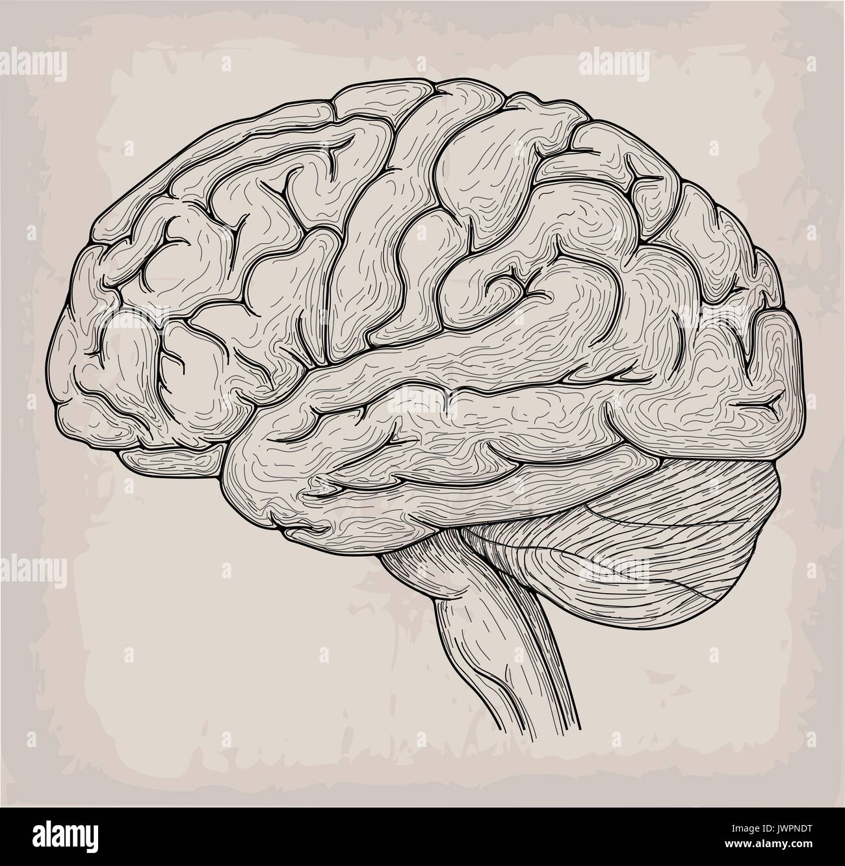
Introduction
The human brain is the most complex organ in the body. It controls thought, memory, emotion, touch, motor skills, vision, breathing, temperature, and many more processes.

Slide 4
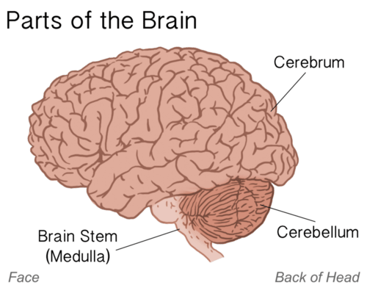
Parts of Human Brain
Cerebrum
Cerebellum
Brainstem
Limbic System
Hypothalamus and Thalamus

Slide 5
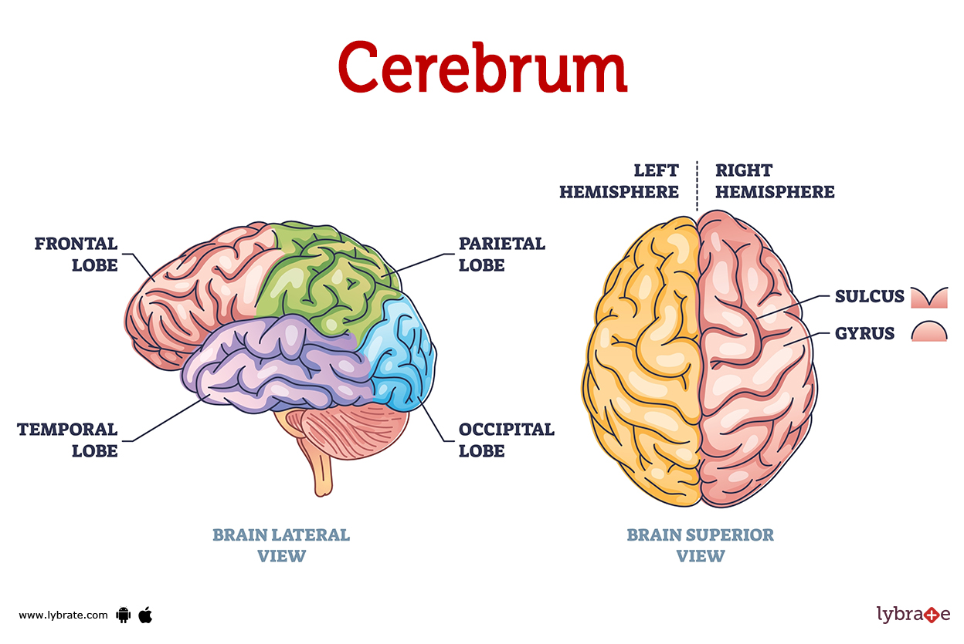
Cerebrum:
The cerebrum is the largest part of the brain, divided into two hemispheres. It controls voluntary actions, speech, senses, thought, and memory.

Slide 6
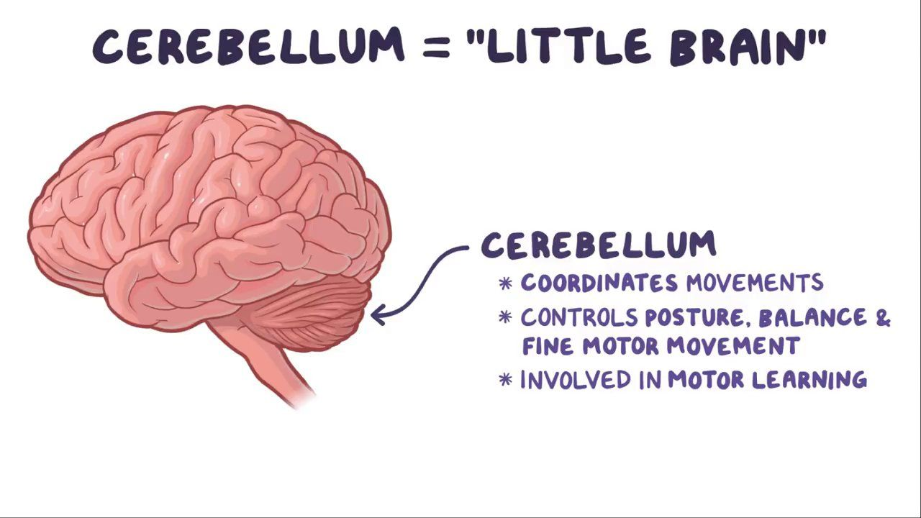
Cerebellum:
Located under the cerebrum, the cerebellum coordinates muscle movements, maintains posture, and balance.

Slide 7
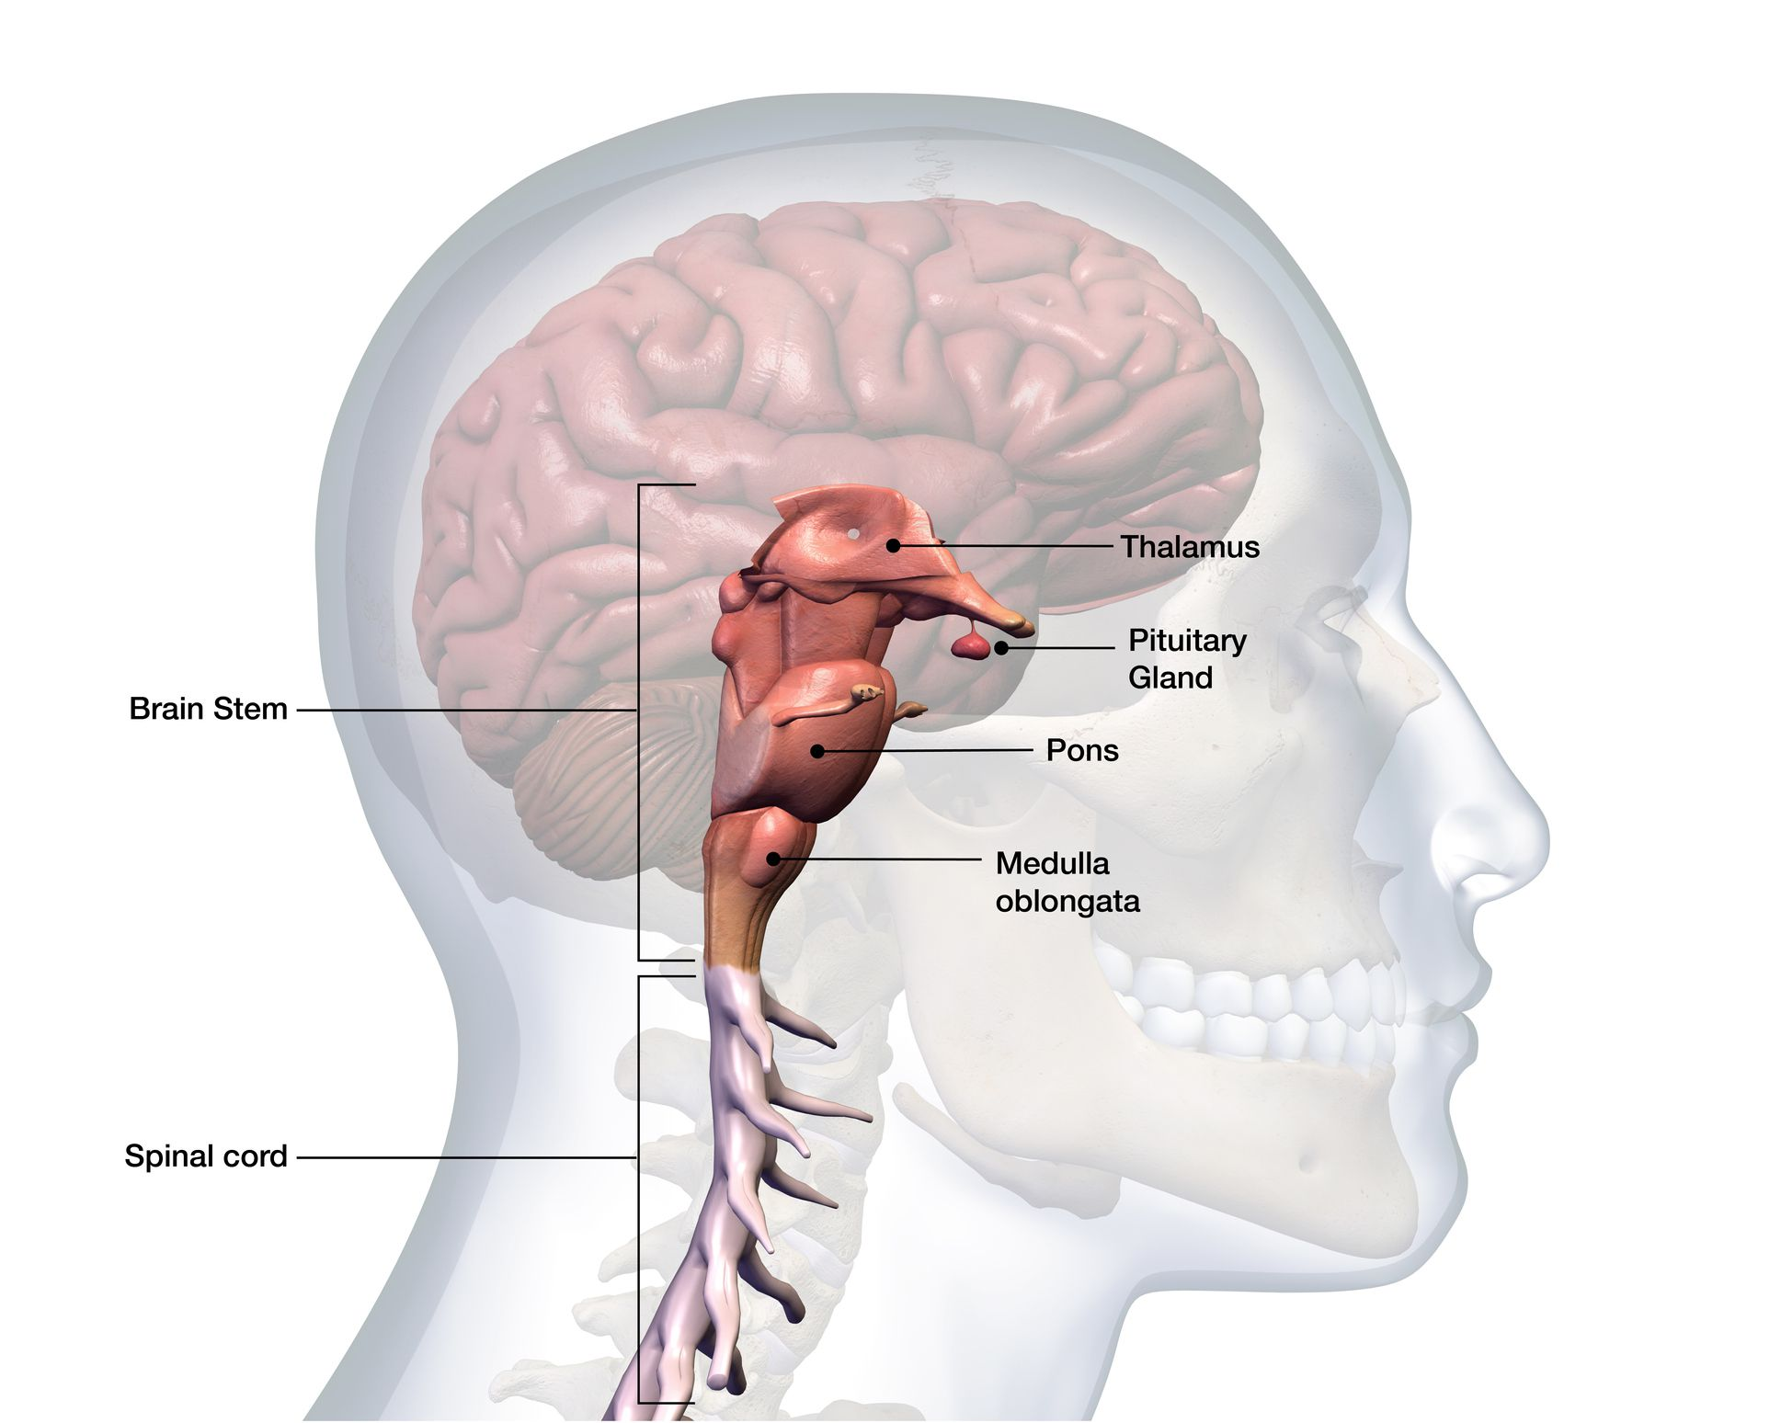
Brainstem:
The brainstem connects the brain with the spinal cord and controls automatic functions such as breathing, heart rate, and blood pressure.

Slide 8
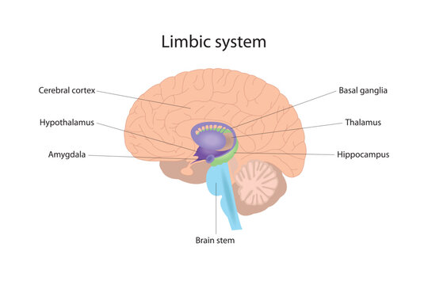
Limbic System:
The limbic system is involved in emotions, memory, and arousal. Key structures include the amygdala and hippocampus.

Slide 9
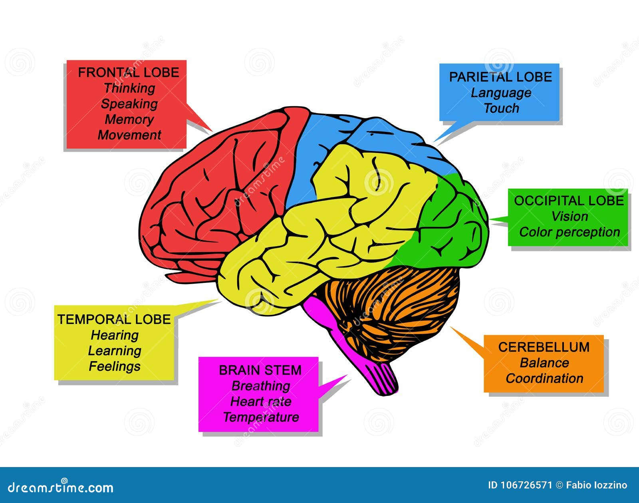
Functions of Human Brain:
Processing sensory information
Controlling motor functions
Emotions and behavior
Memory and learning
Homeostasis

Slide 10
Conclusion:
The human brain is a complex and powerful organ that plays a crucial role in nearly every aspect of our lives. Understanding its structure and functions helps us appreciate its significance in health and disease.

Slide 11
Thank You
By : Dimple Singh
Batch I.D. : 241004514302

